Slide 1



A320 FFS
Maintenance Technician
Training Course
Prepared By: Mohamed Sakr
Instructor Operating Station (IOS)
Thales Training & Simulation

Slide 2
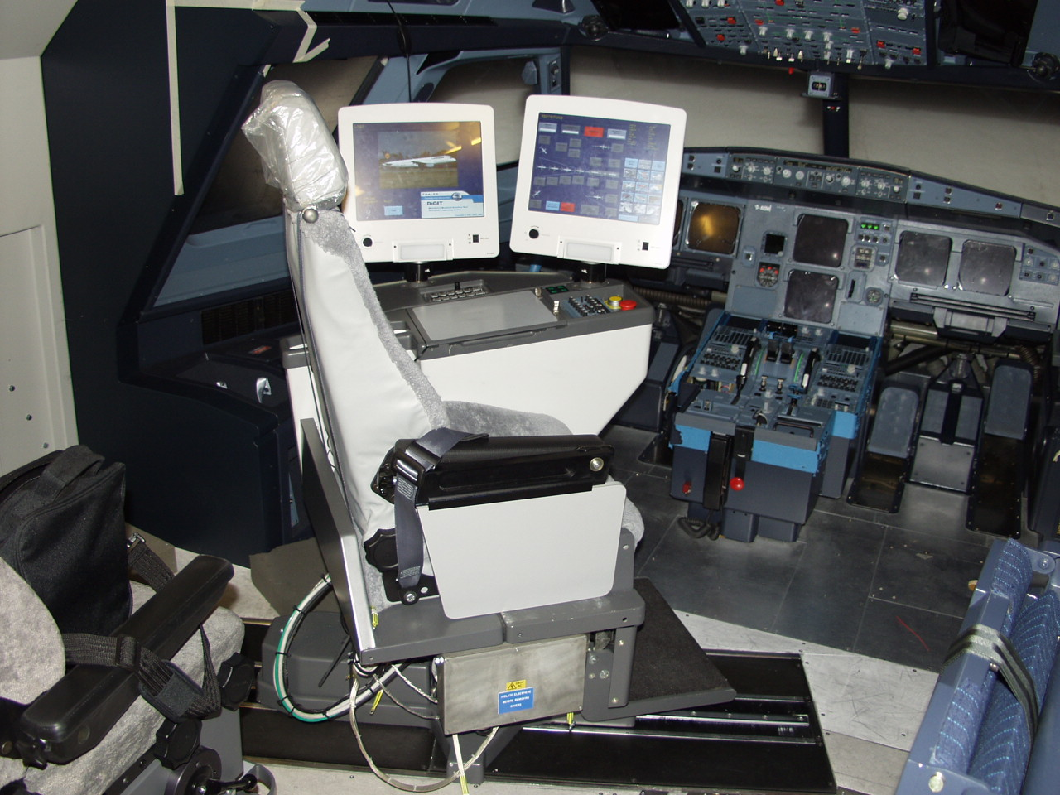

Slide 3
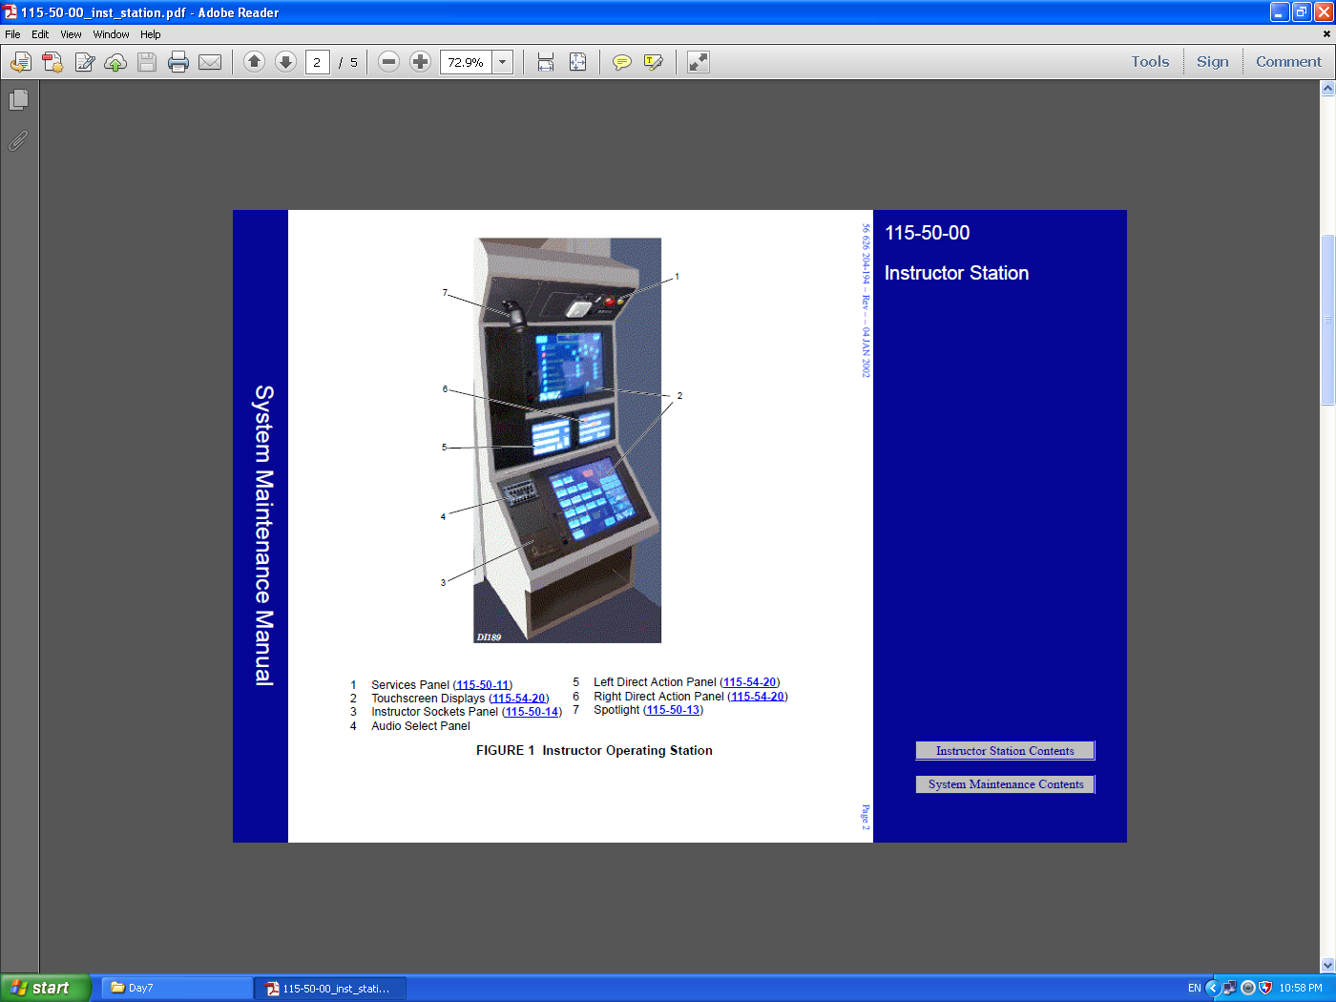

Slide 4
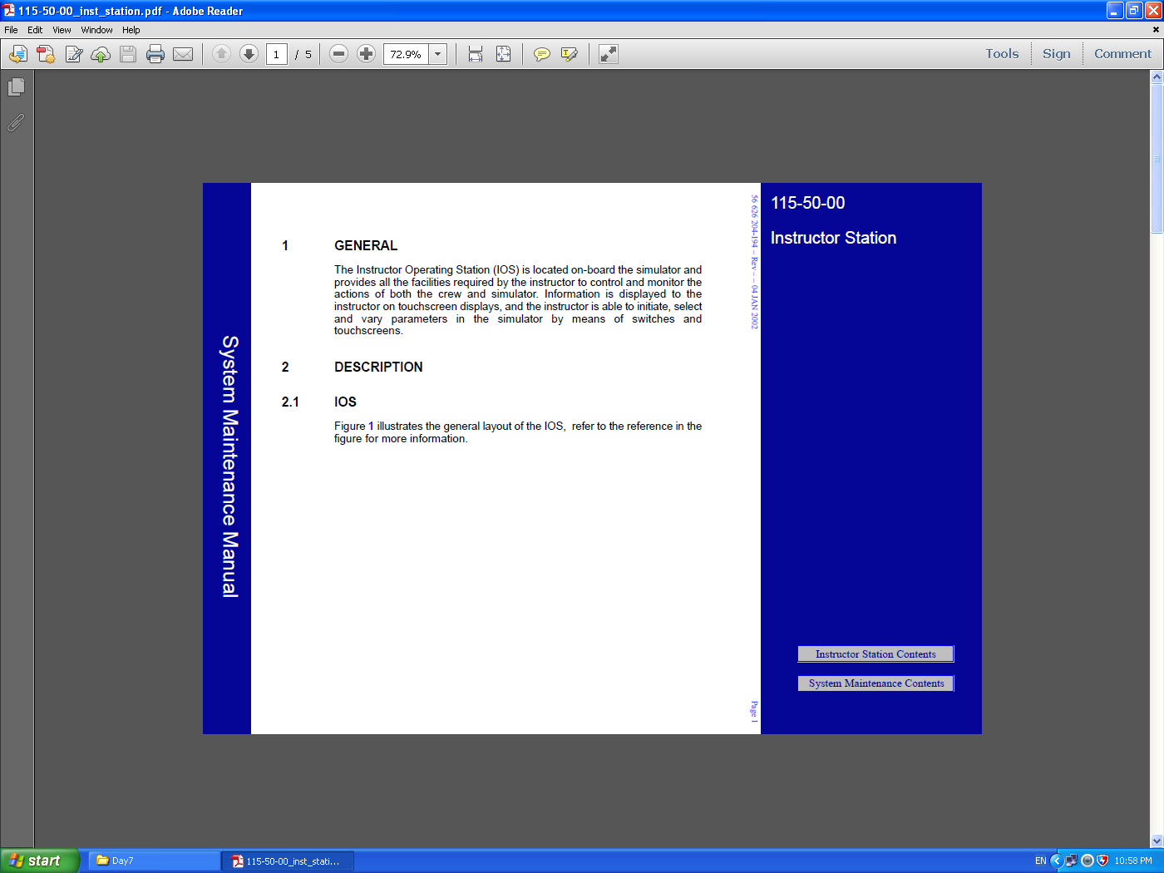

Slide 5
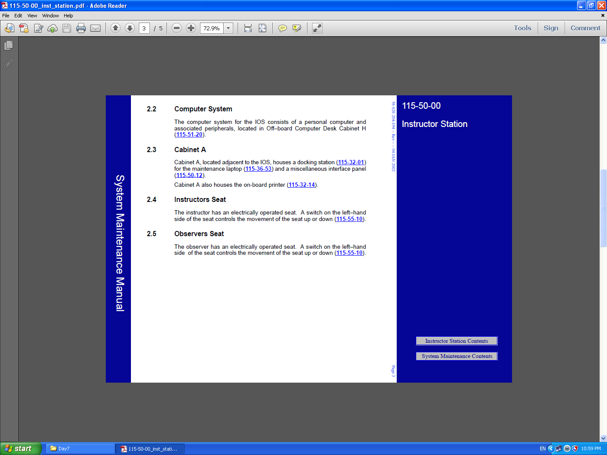

Slide 6
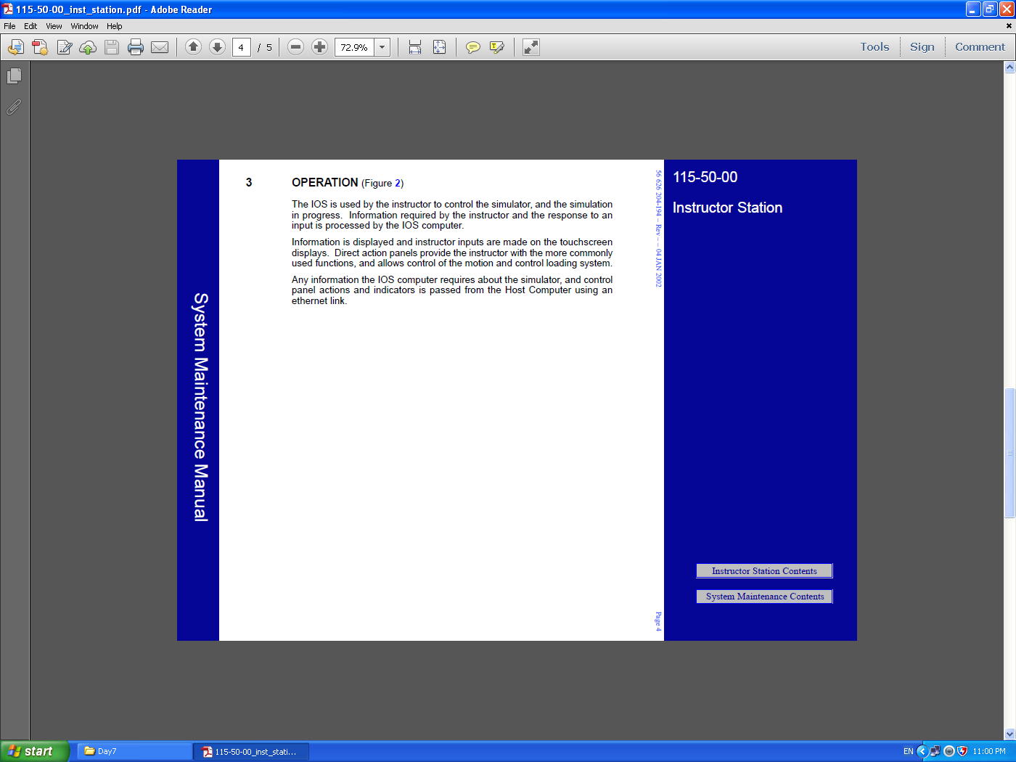

Slide 7
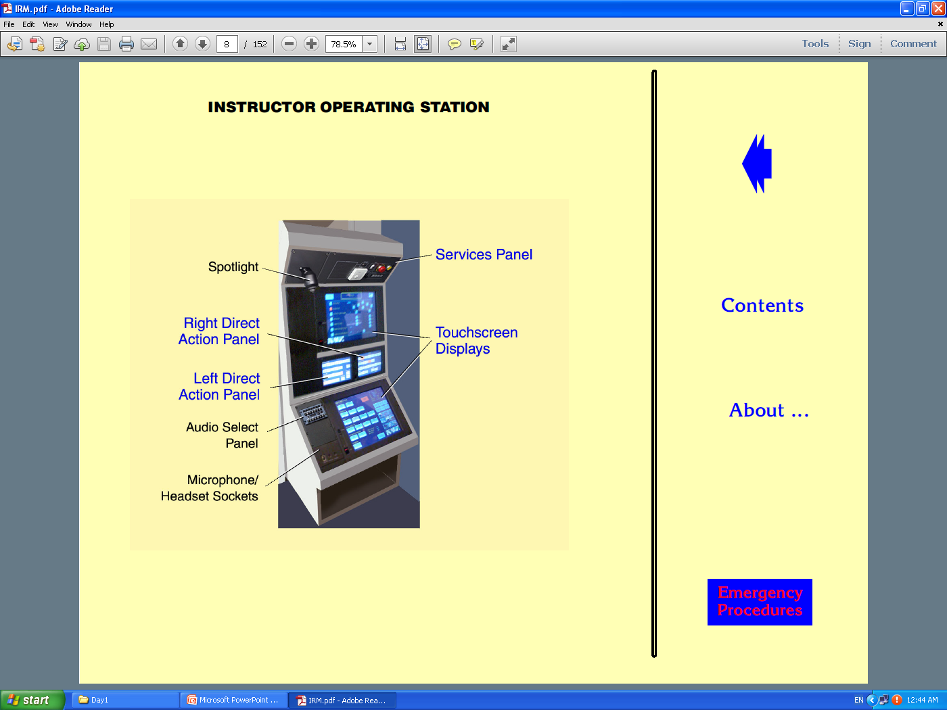

Slide 8
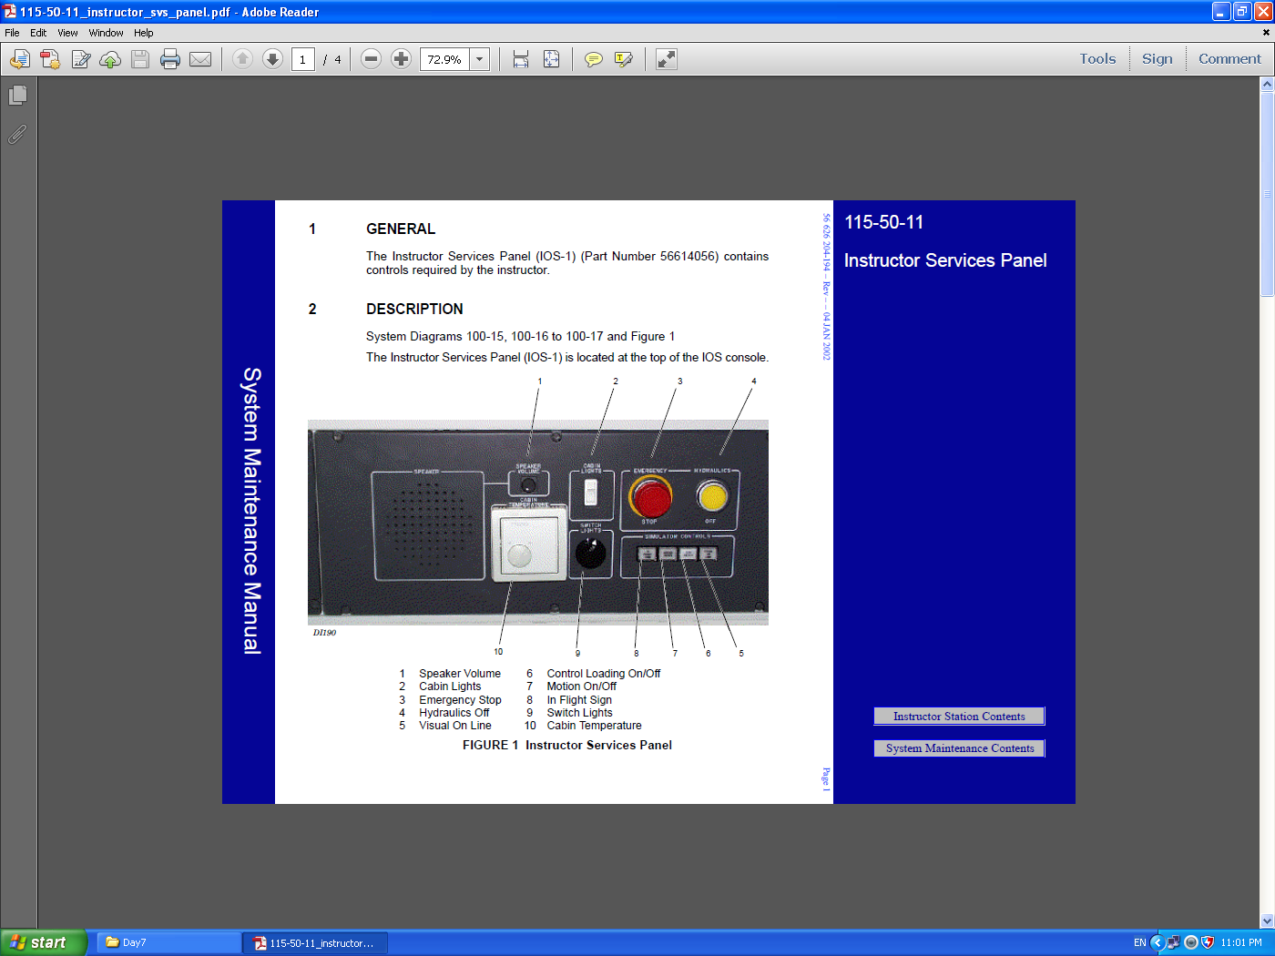

Slide 9
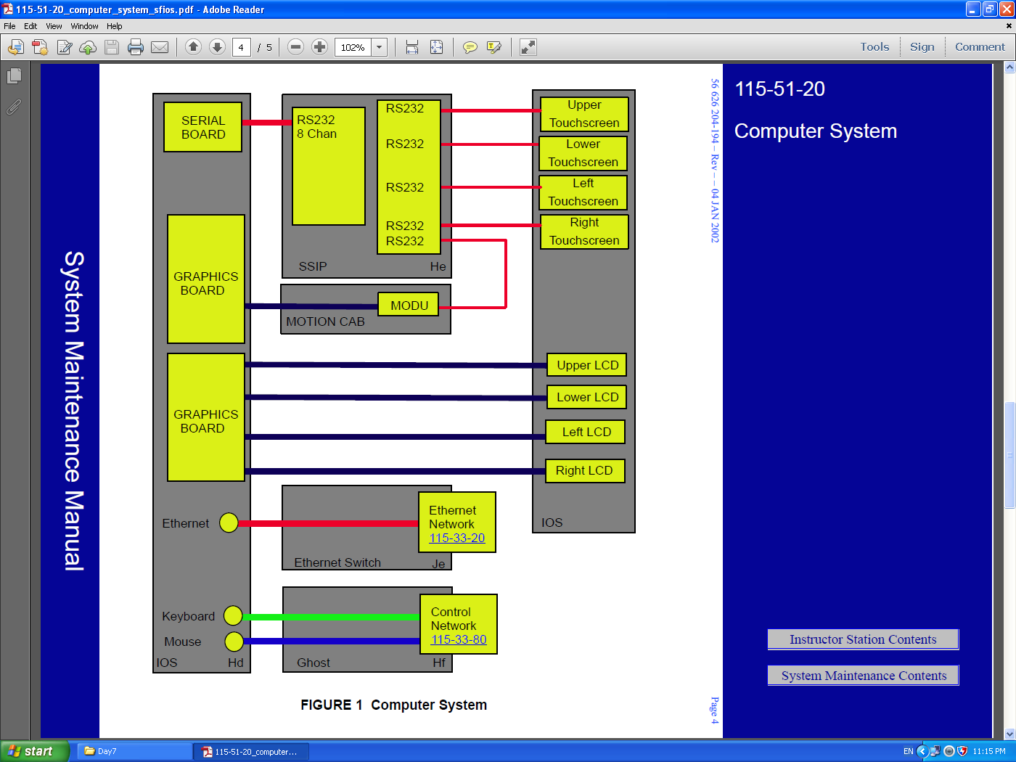

Slide 10
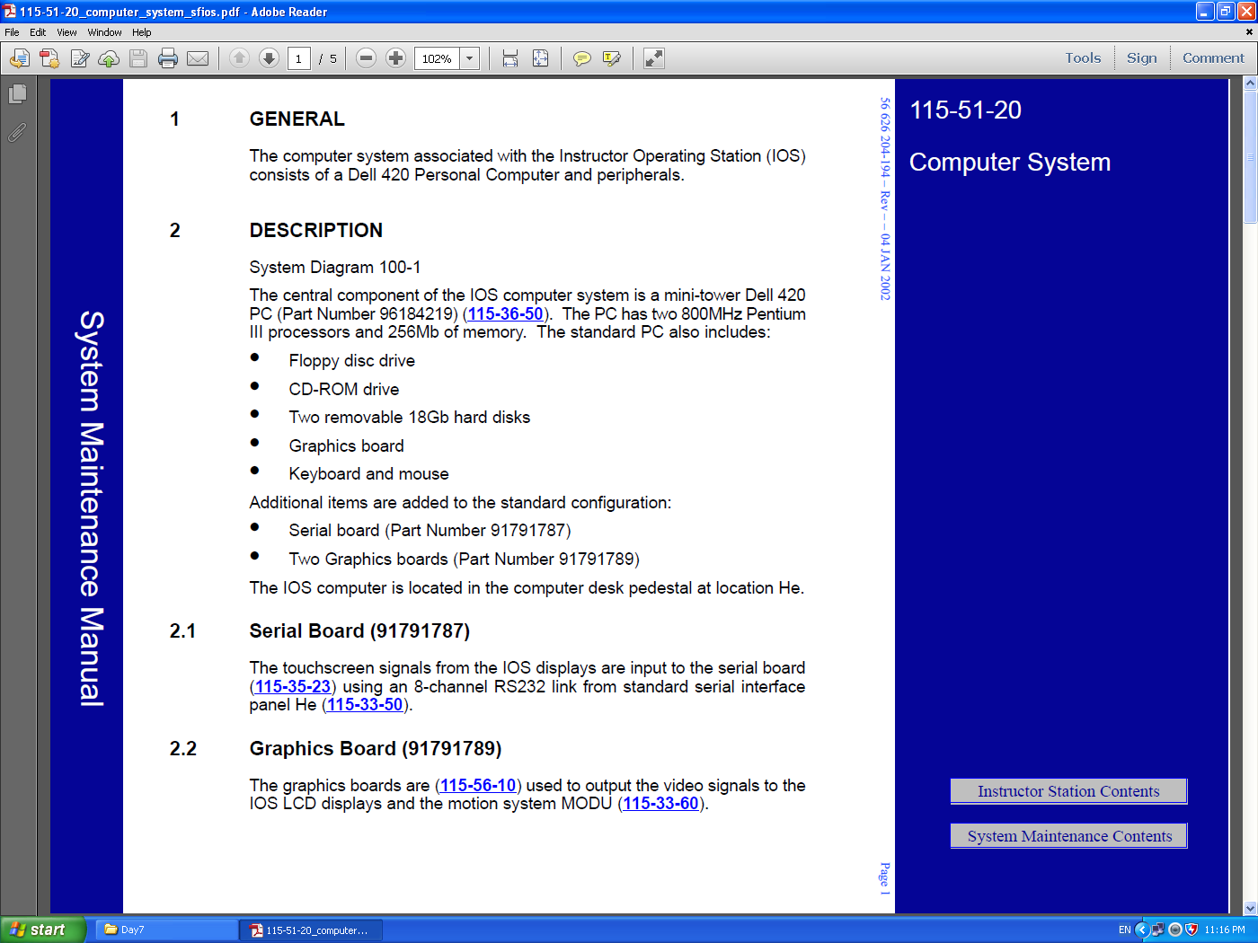

Slide 11
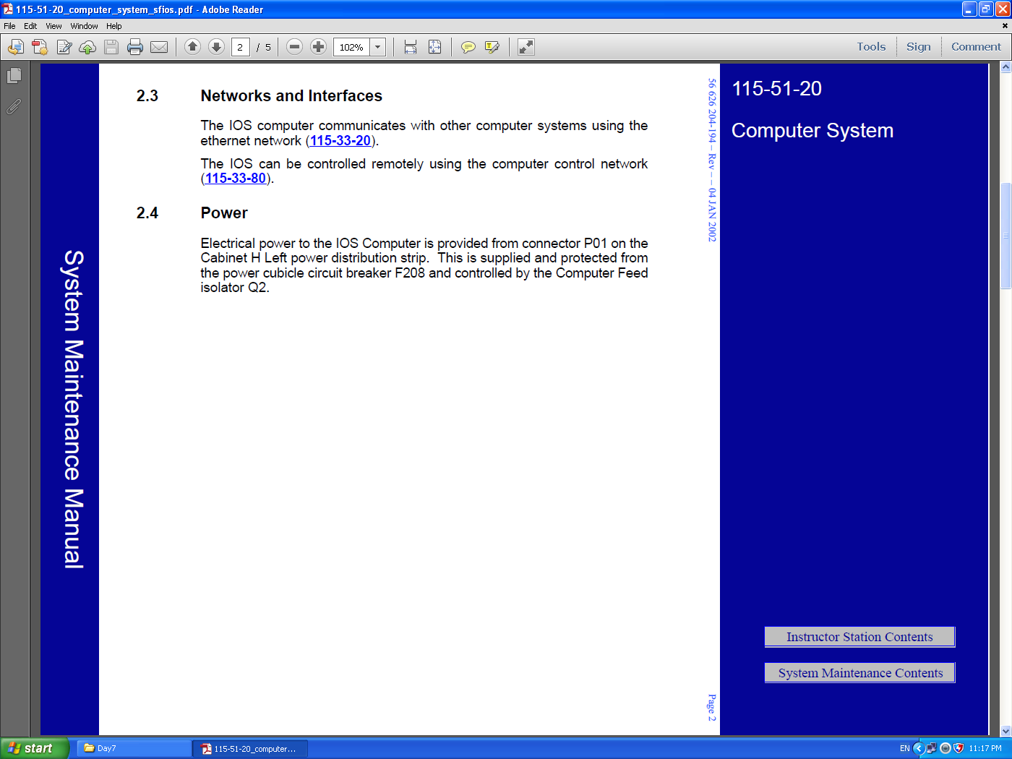

Slide 12


Slide 13
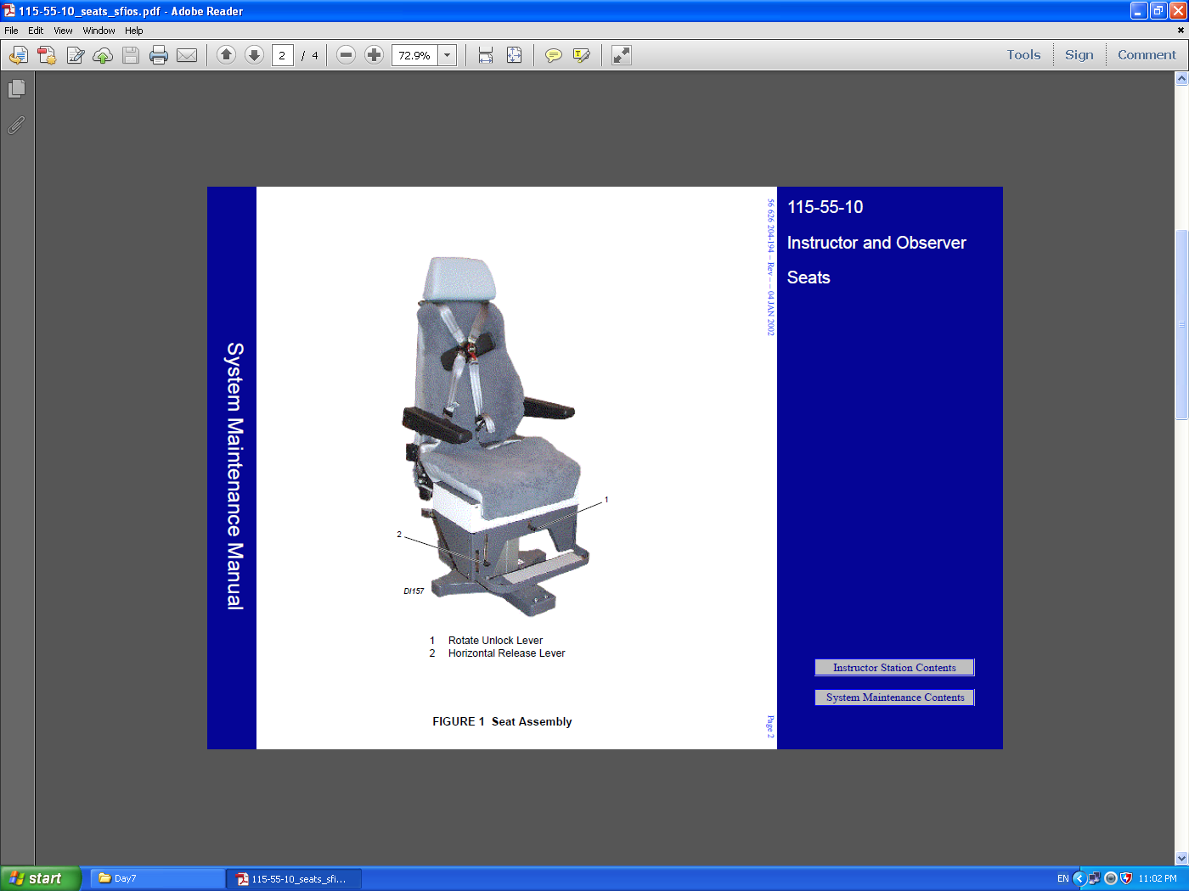

Slide 14


References : THALES STD simulator Manufacture manual .
?
Please Feel free to Ask
Practical

